Slide 1

Skyscraper Information
Visualized data for important skyscrapers in big cities of USA
Angela Shi
12/12/2017

Slide 2



Who this website works for?
Children to learn
Travelers who want to know more
Specialists for database

Slide 3
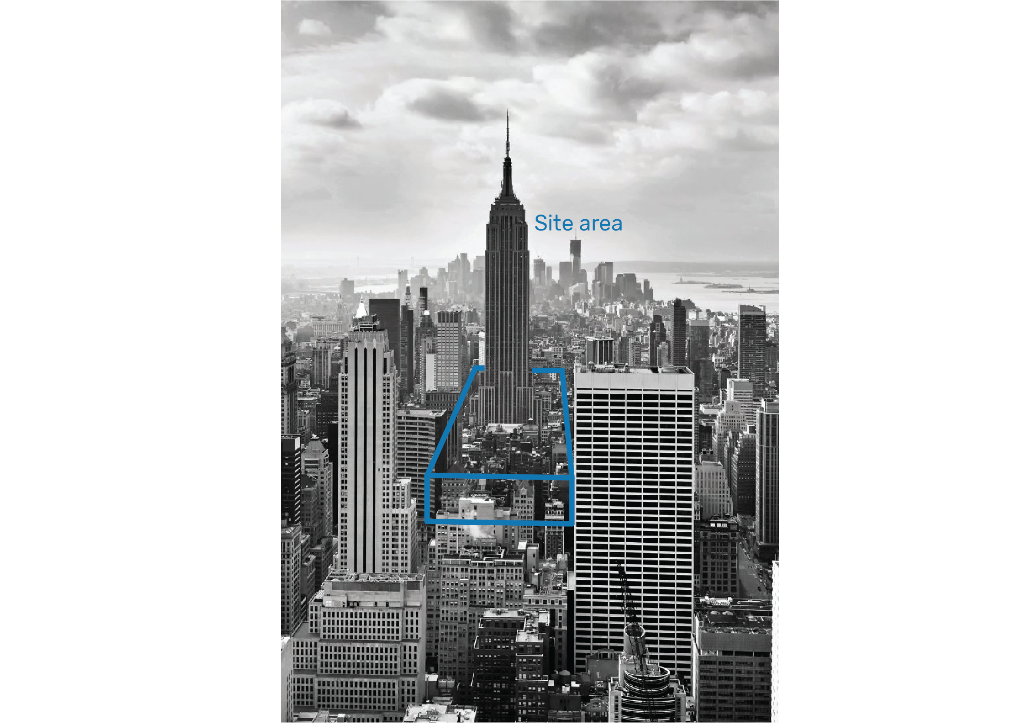
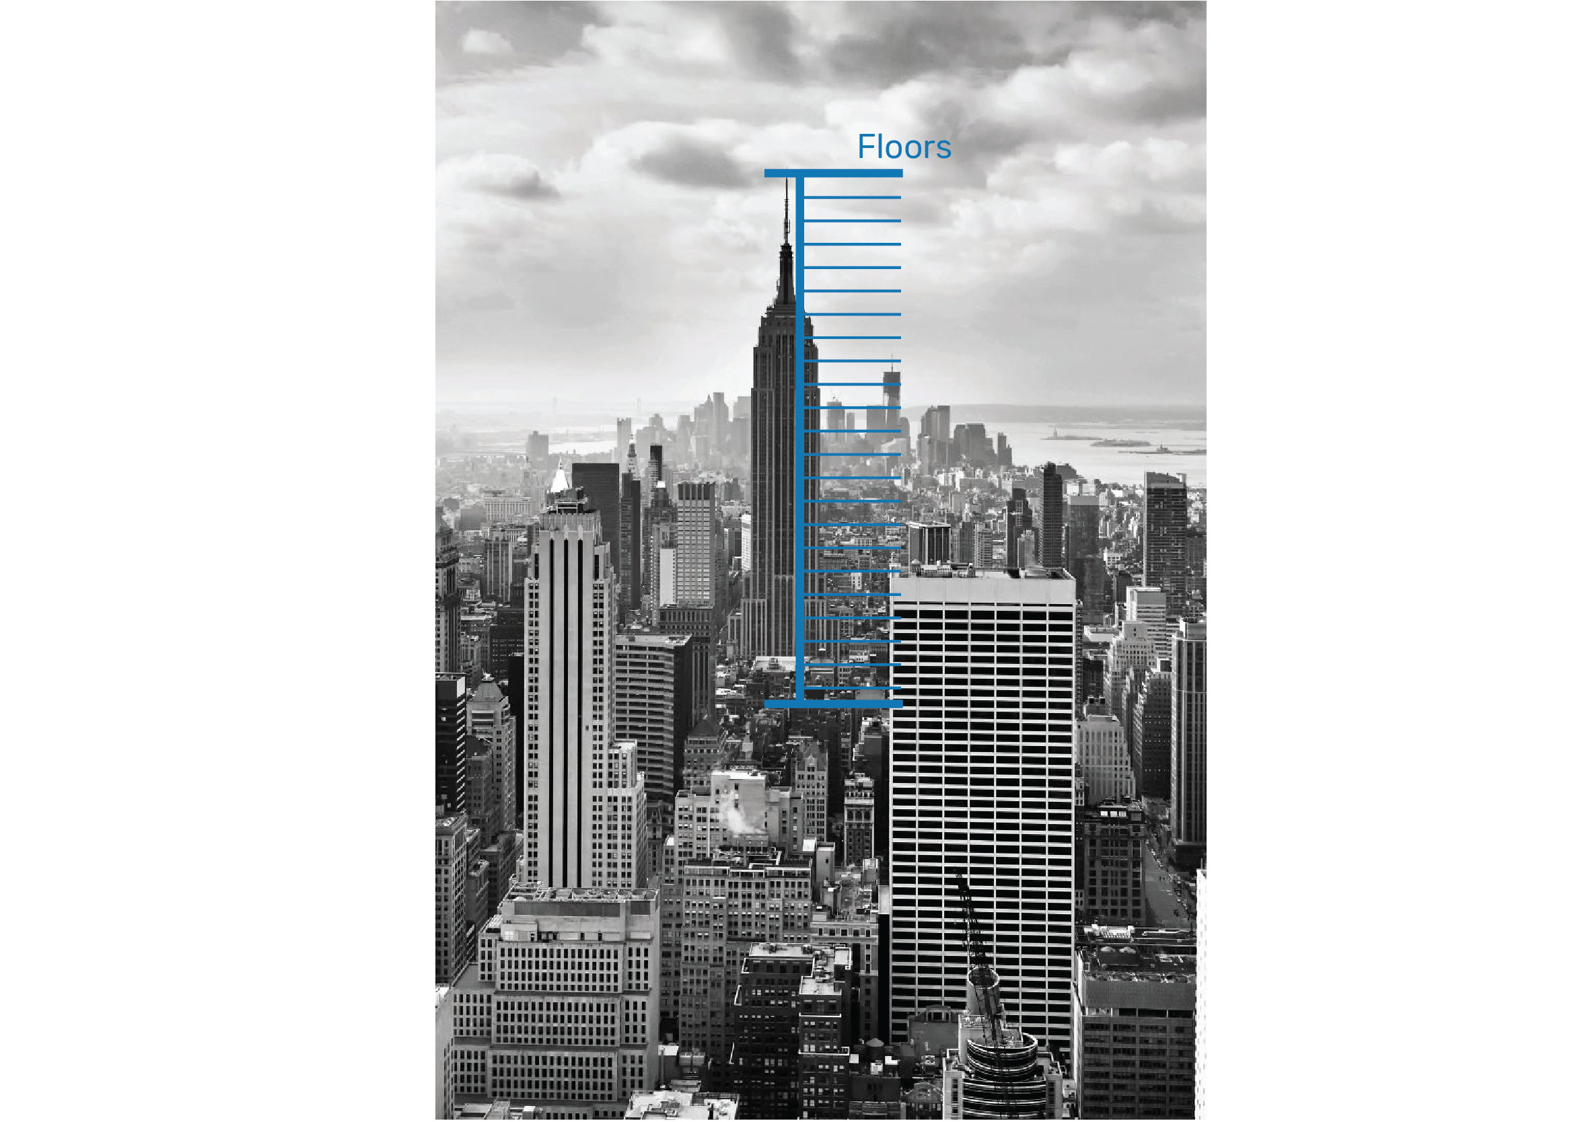
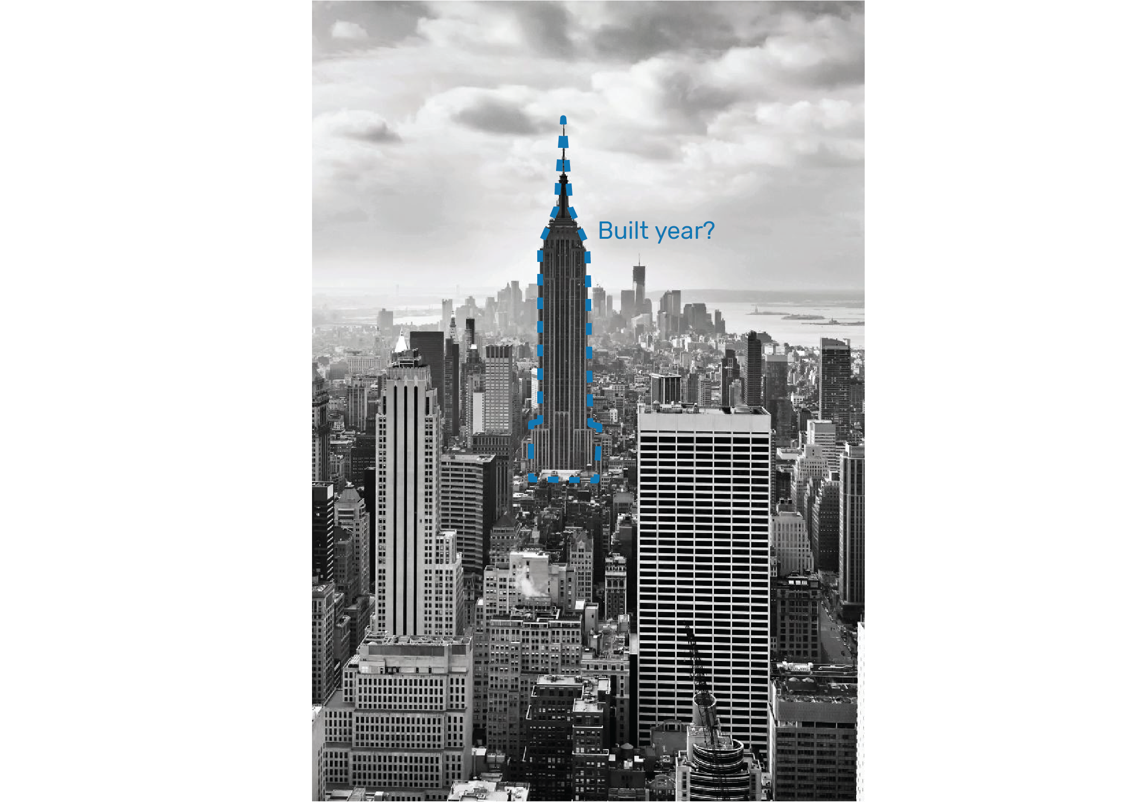
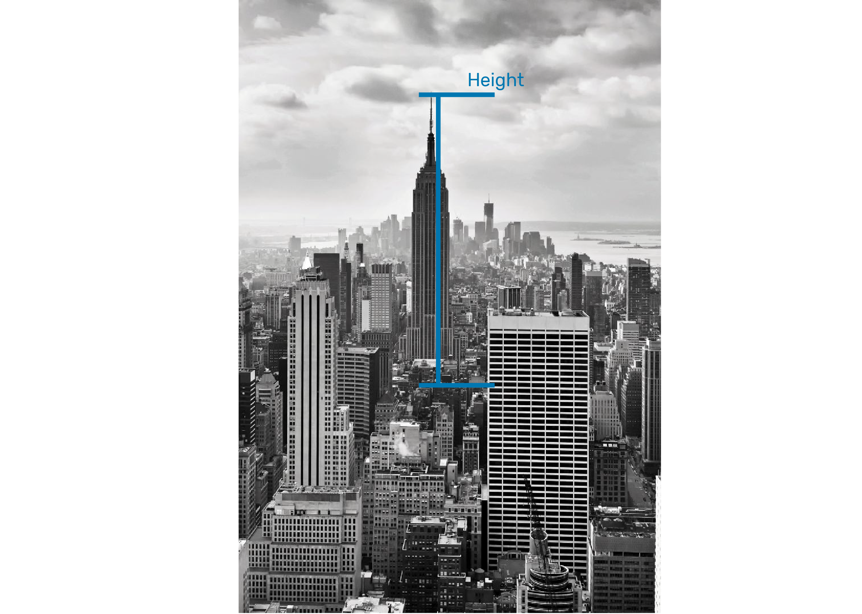
The height of building
Number of floors
Total site area
The built year
What kind of Information we provide?

Slide 4
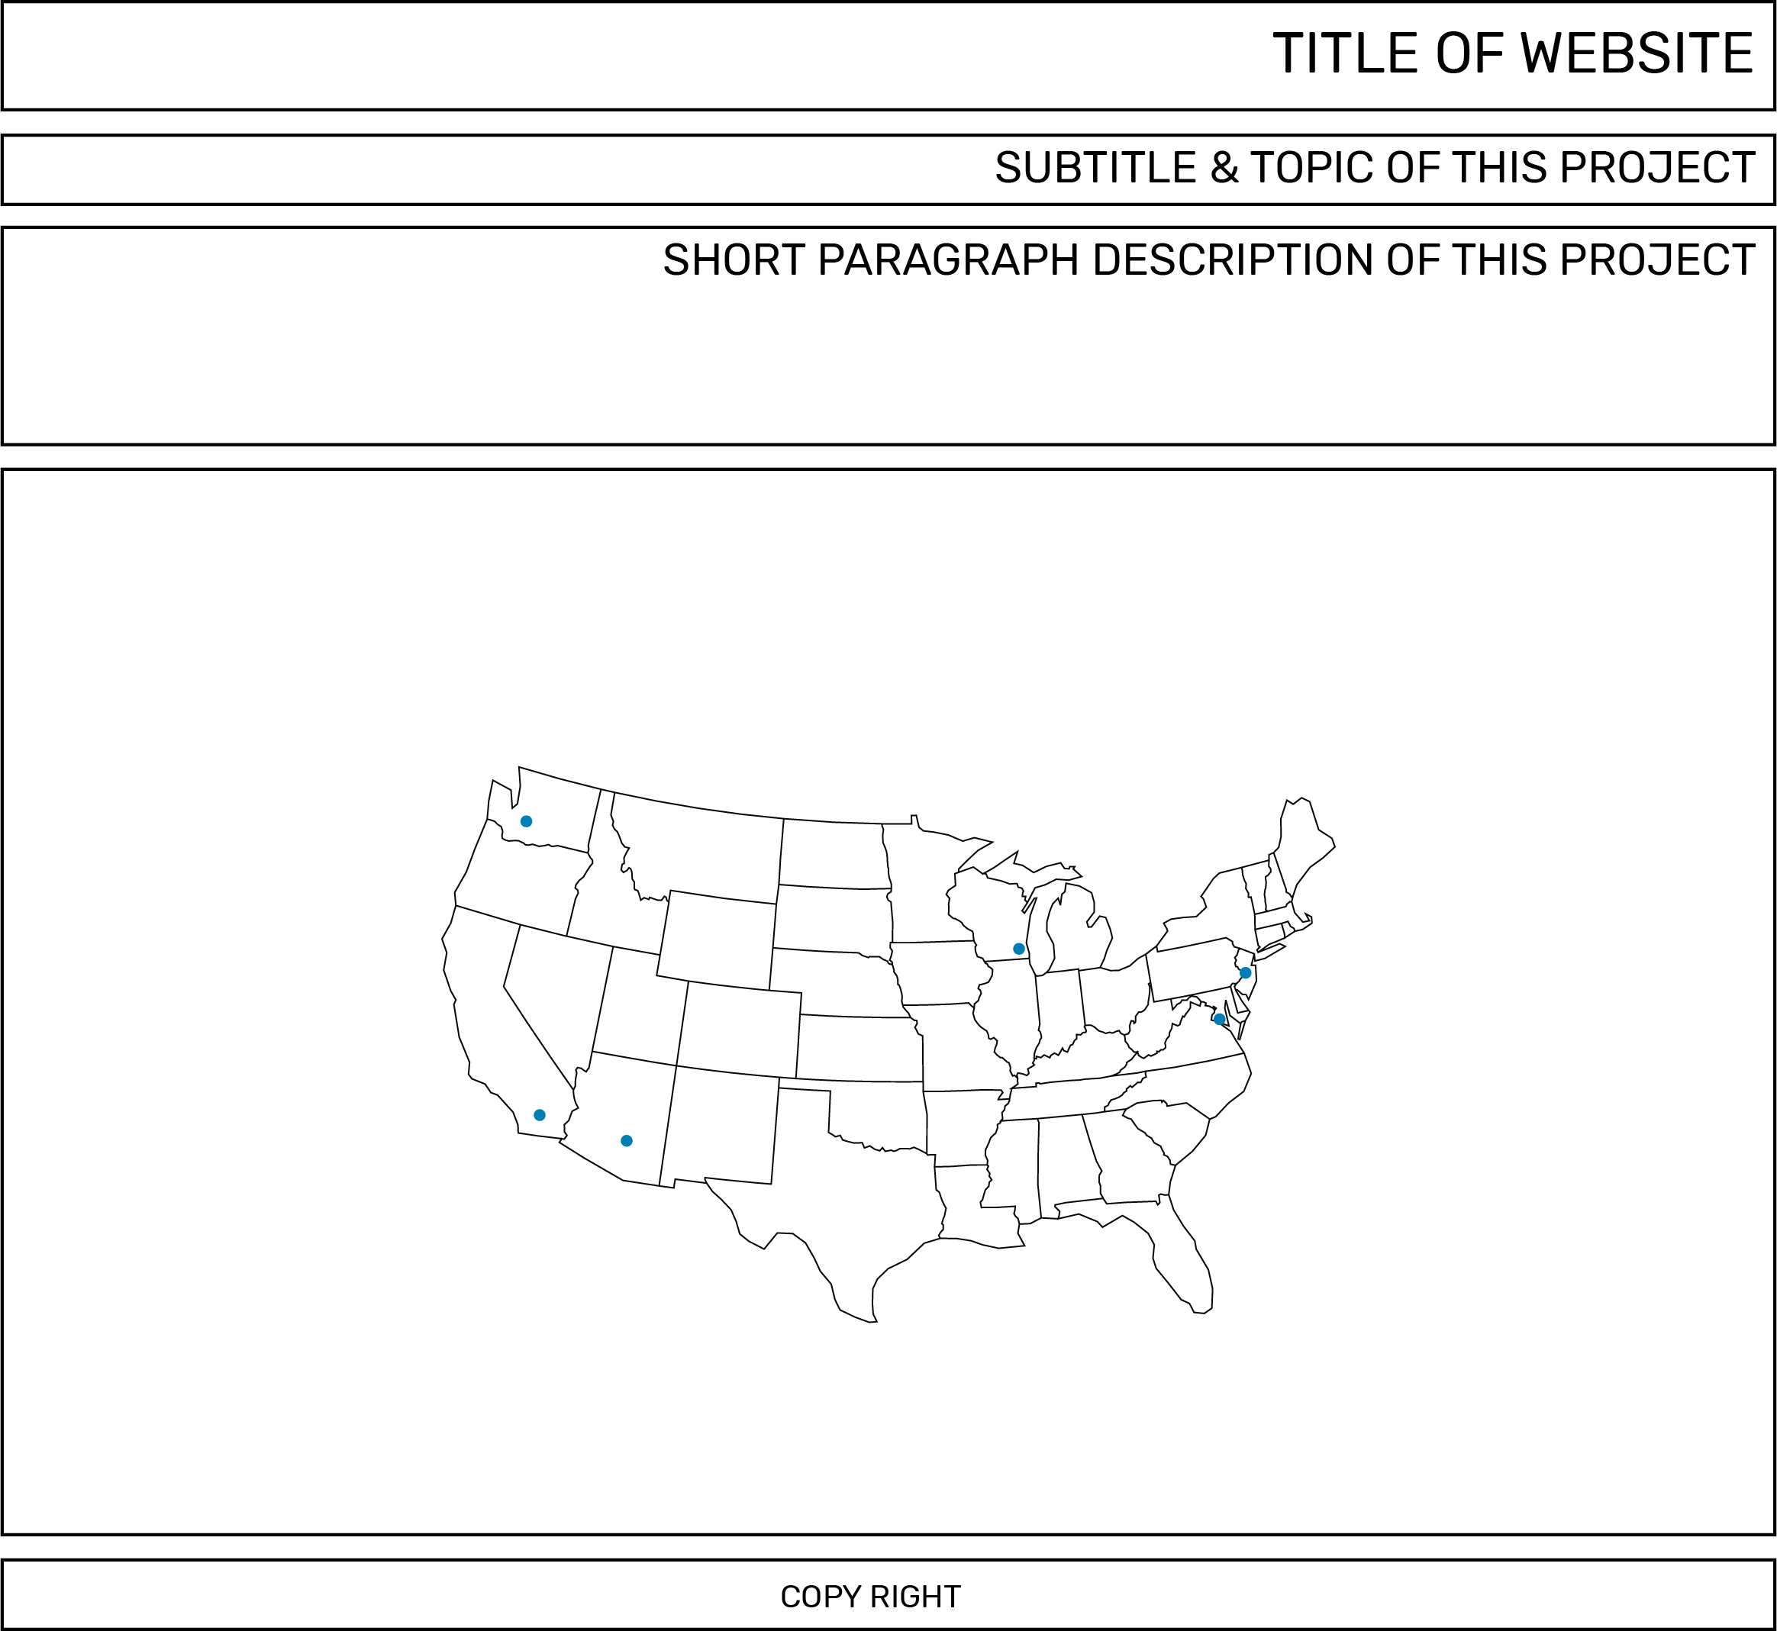
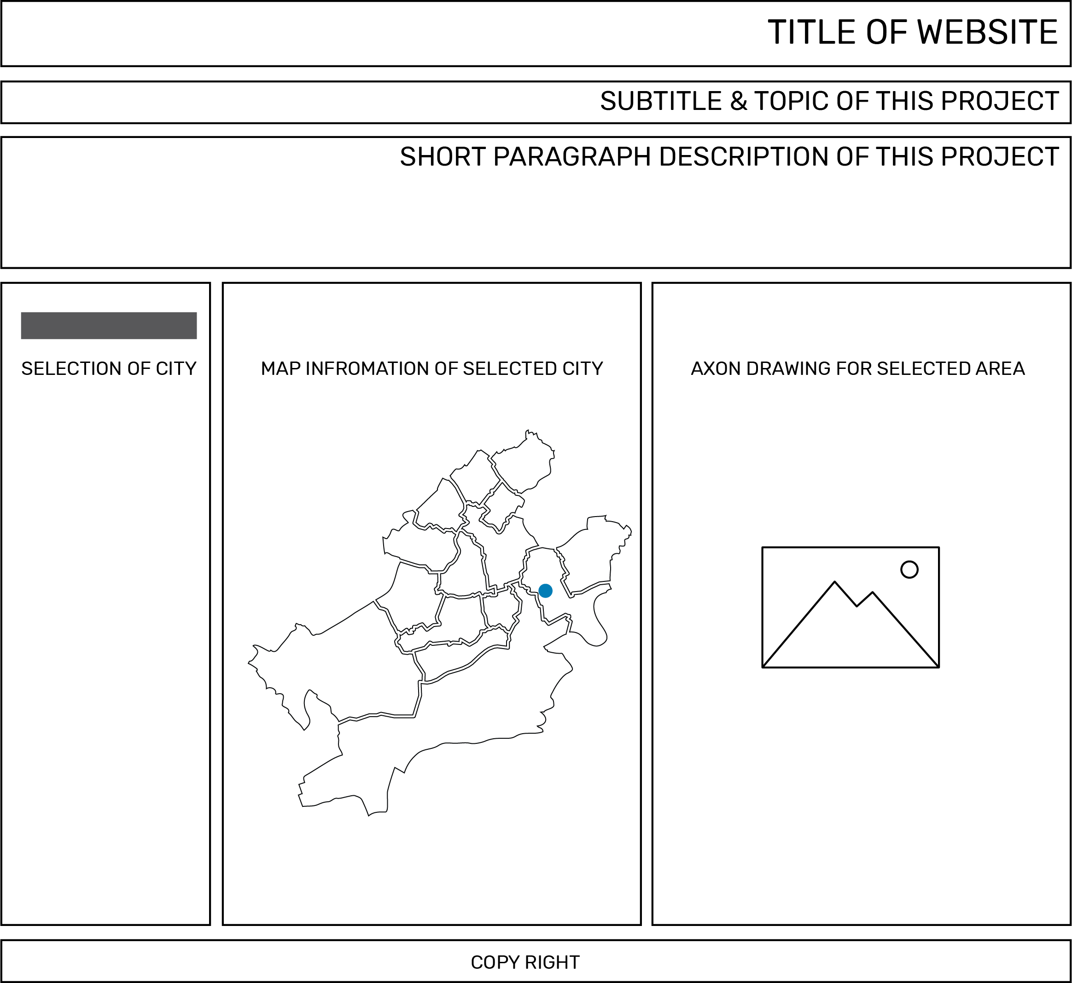
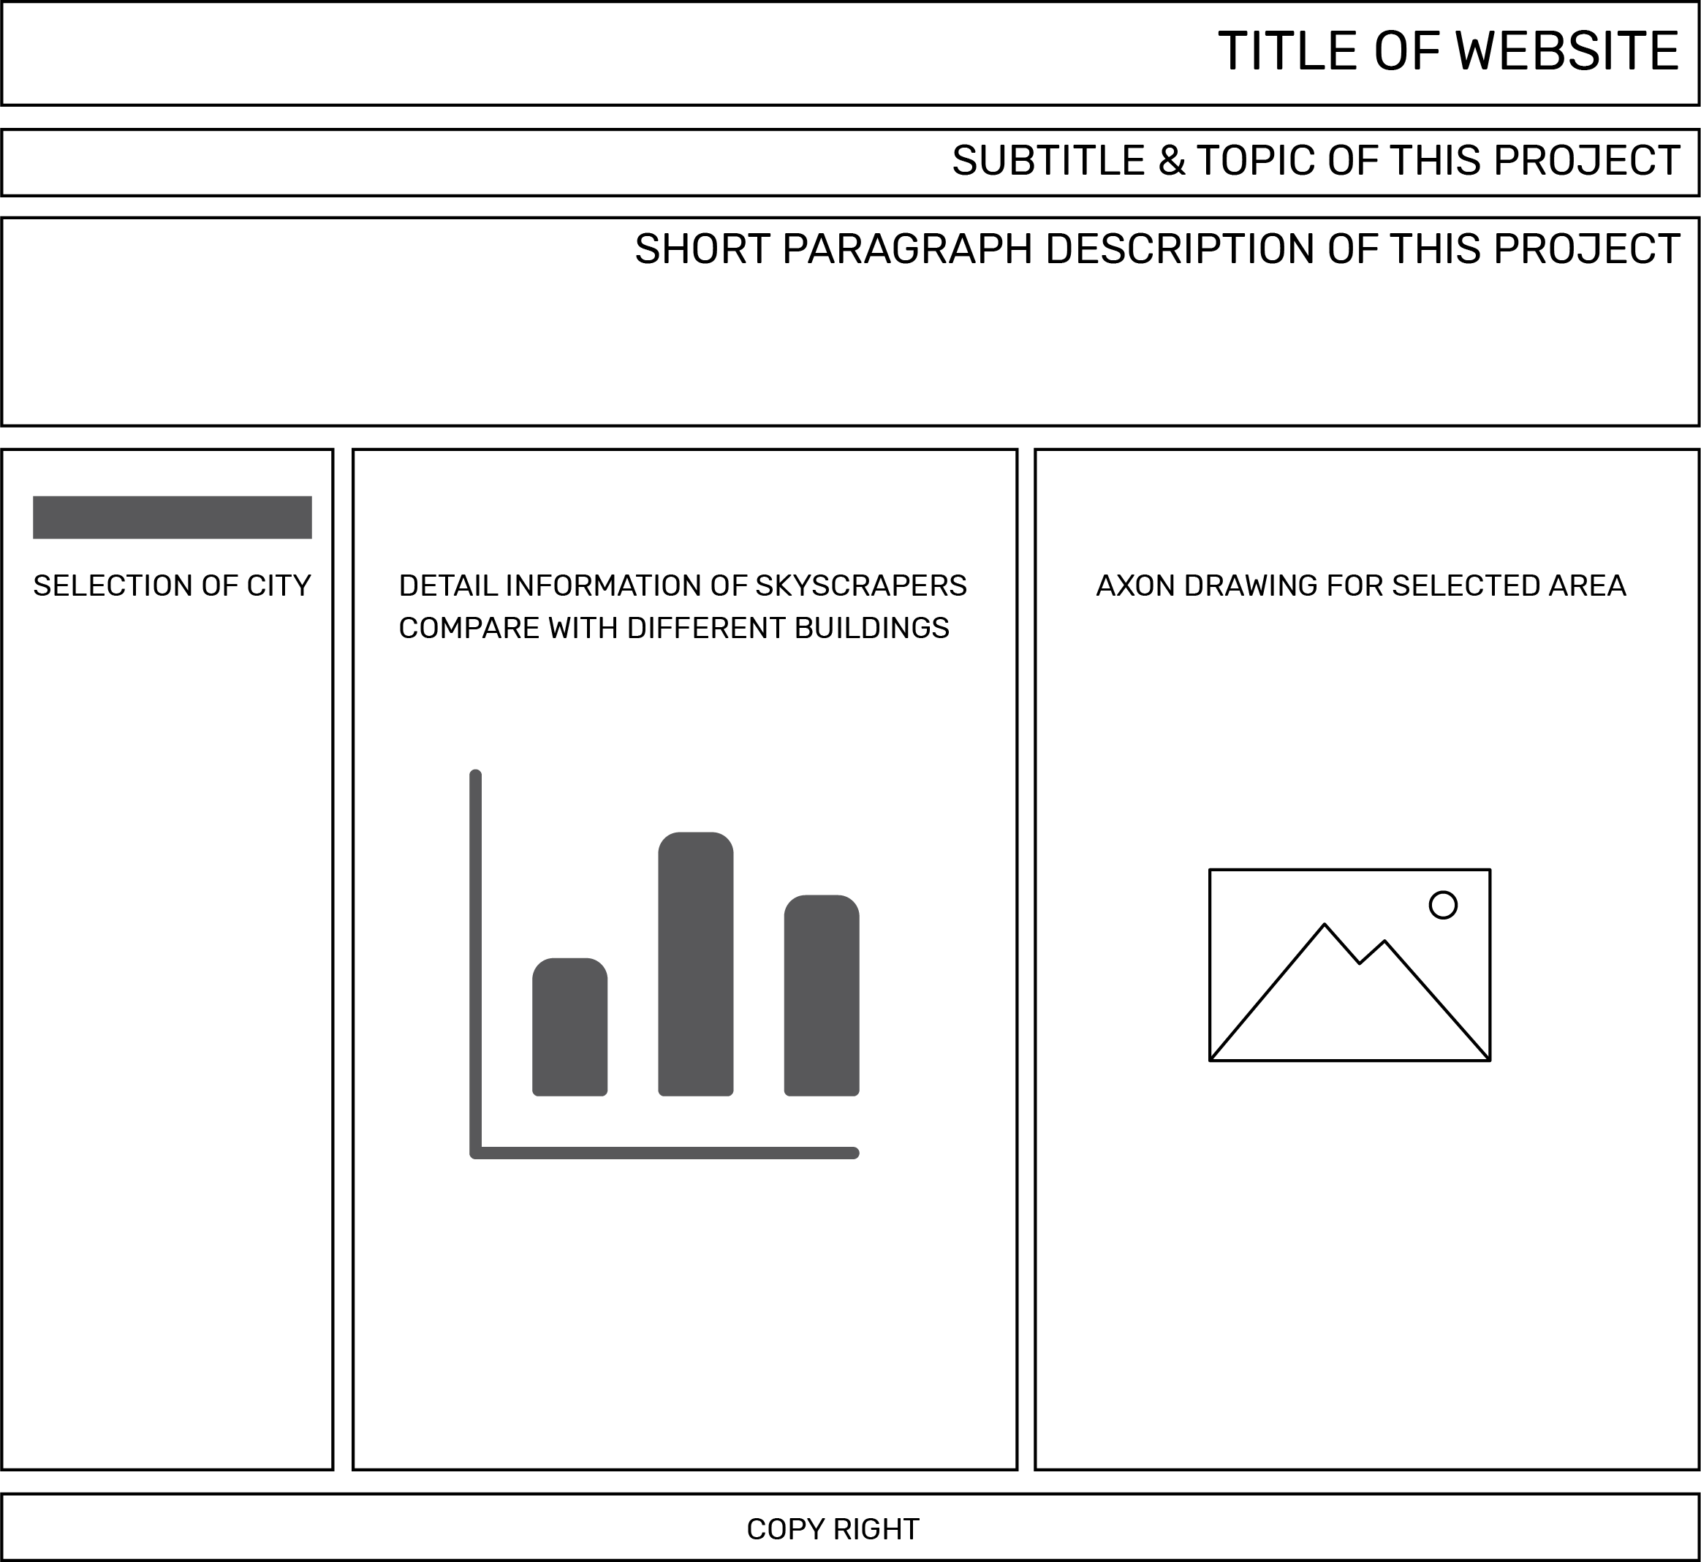
Interface of the Data Website
Welcome page of the website
Select city and show the image of downtown
Compare data of the tallest buildings
Link address for the website

Slide 5
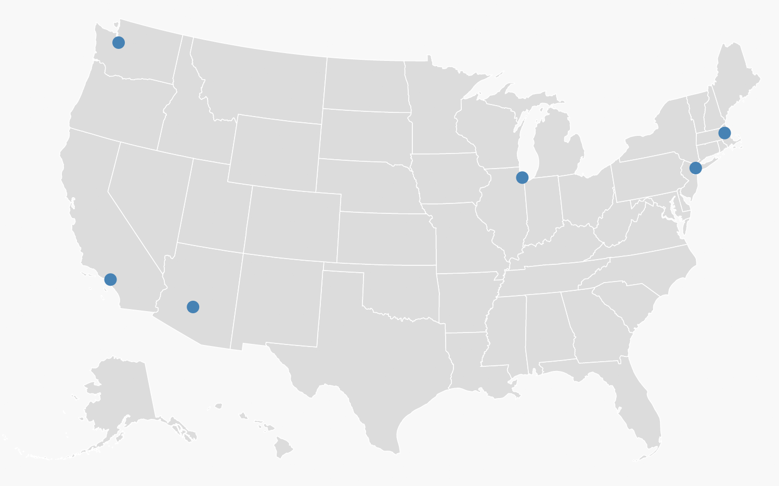
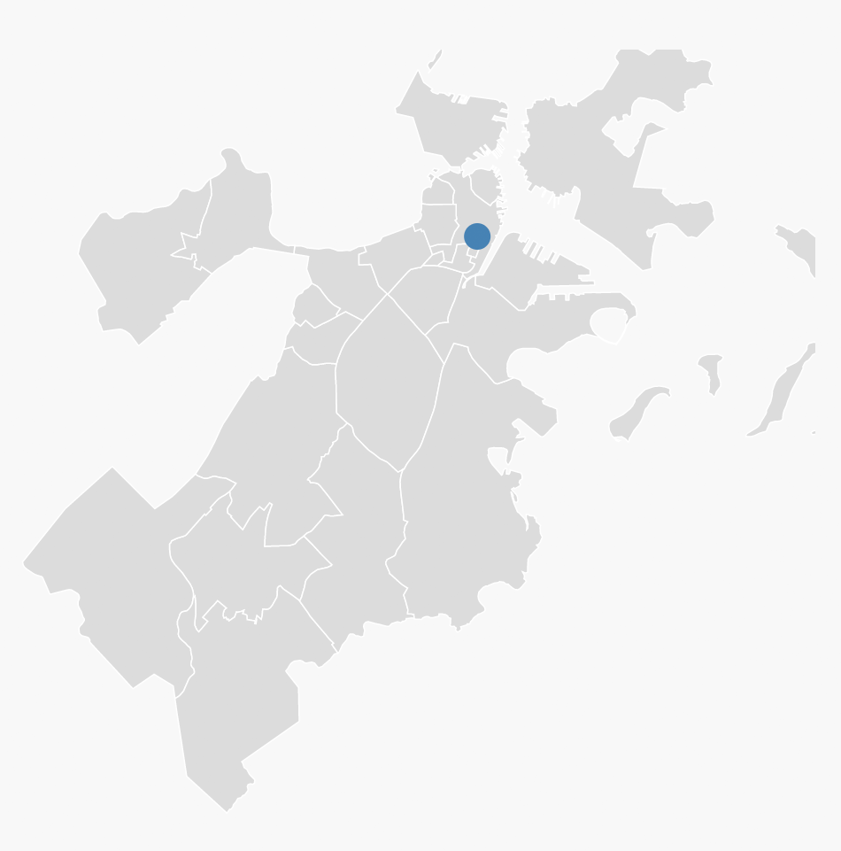
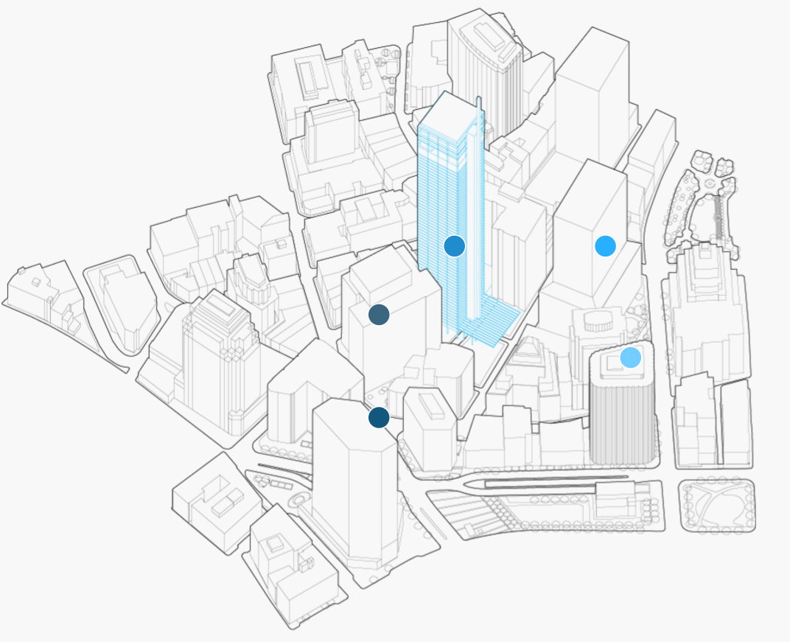
What user can learn from the website?
State Lever
City Lever
Area Lever
What kind of city could be called big city?
How many big cities in USA?
How many districts a city has?
Typical buildings in each area.
Highest buildings (appearance) in this area
Basic data for each of them

Slide 6
Situation and further possibility of the project
Now
Future
Structure of the project
Country
City
Area
Building
Functions of the project
Geo map information
Tooltip to show name of area
Zoom in function for area
Click dot to jump into building information
Tooltip for building information
Data Comparison
Structure of the project
Country
City -> more cities; size of the circle to show the bigness of each city
Area -> more areas
Building -> more buildings
Functions of the project
Geo map information
Tooltip to show name of area
Zoom in function for area
Click dot to jump into building information
Tooltip for building information
Tour path in the area
Data Comparison
Select compare buildings

